Slide 1
PIZZA SALES ANALYSIS
JAYA KUSHAL

Slide 2
Overview
The goal of this SQL project is to analyze pizza sales data to gain insights into customer behavior, popular
pizza types, sales trends, and overall performance. The analysis will be performed using four tables:
order_details, orders, pizza_type, and pizza.

Slide 3
DATASET
1. order_details
order_details_id: Unique identifier for the order detail.
order_id: Identifier linking to the orders table.
pizza_id: Identifier linking to the pizza table.
quantity: Number of pizzas ordered.
2. orders
order_id: Unique identifier for the order.
date: Date the order was placed.
time: Time the order was placed.

Slide 4
DATASET
3. pizza_type
pizza_type_id: Unique identifier for the pizza type.
name: Name of the pizza.
category: Category of the pizza (e.g., vegetarian, meat, etc.).
Ingredients: List of ingredients used in the pizza.
4. pizza
pizza_id: Unique identifier for the pizza.
pizza_type_id: Identifier linking to the pizza_type table.
size: Size of the pizza (e.g., small, medium, large).
price: Price of the pizza.

Slide 5
Queries to be written
--Q1: The total number of order place
-- Q2: The total revenue generated from pizza sales
-- Q3: The highest priced pizza.
-- Q4: The most common pizza size ordered.
-- Q5: The top 5 most ordered pizza types along their quantities.
-- Q6: The quantity of each pizza categories ordered.
-- Q7: The distribution of orders by hours of the day.
-- Q8: The category-wise distribution of pizzas.
-- Q9: The average number of pizzas ordered per day.
-- Q10: Top 3 most ordered pizza type base on revenue.
-- Q11: The percentage contribution of each pizza type to revenue.
-- Q12: The cumulative revenue generated over time.
-- Q13: The top 3 most ordered pizza type based on revenue for each pizza category.

Slide 6
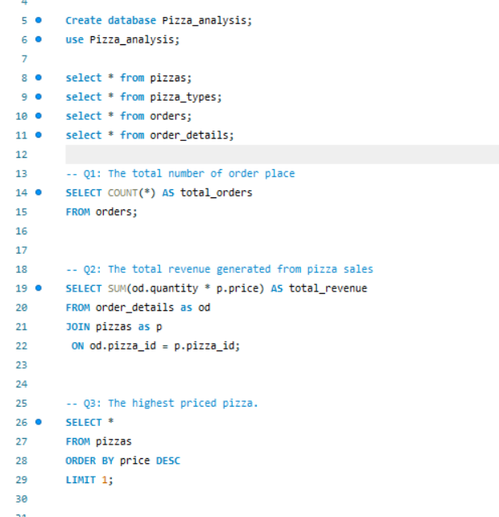



Q1: The total number of order place
Q2: The total revenue generated from pizza sales
Q3: The highest priced pizza.

Slide 7
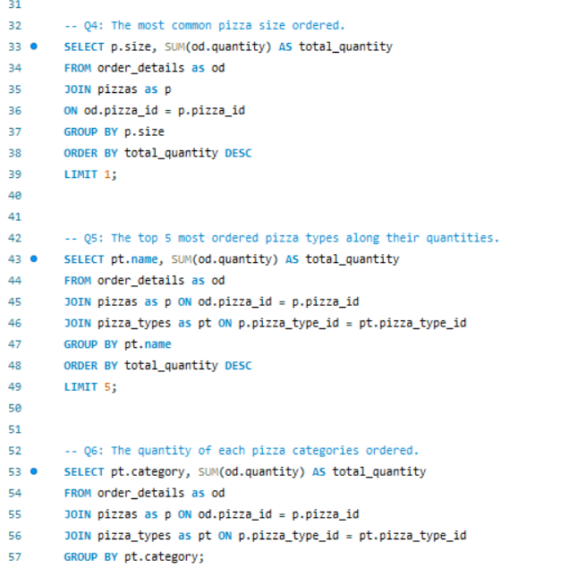

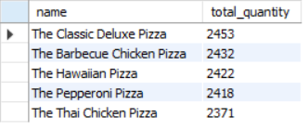
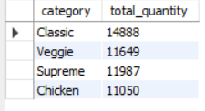
Q4: The most common pizza size ordered.
Q5: The top 5 most ordered pizza types along their quantities.
Q6: The quantity of each pizza categories ordered.

Slide 8
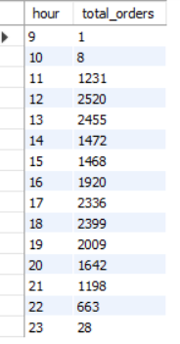
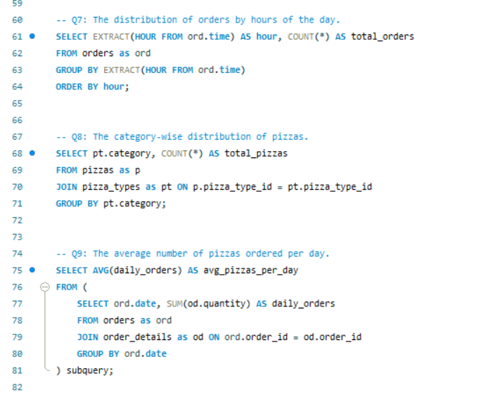
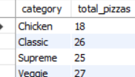

Q7: The distribution of orders by hours of the day.
Q8: The category-wise distribution of pizzas.
Q9: The average number of pizzas ordered per day.

Slide 9
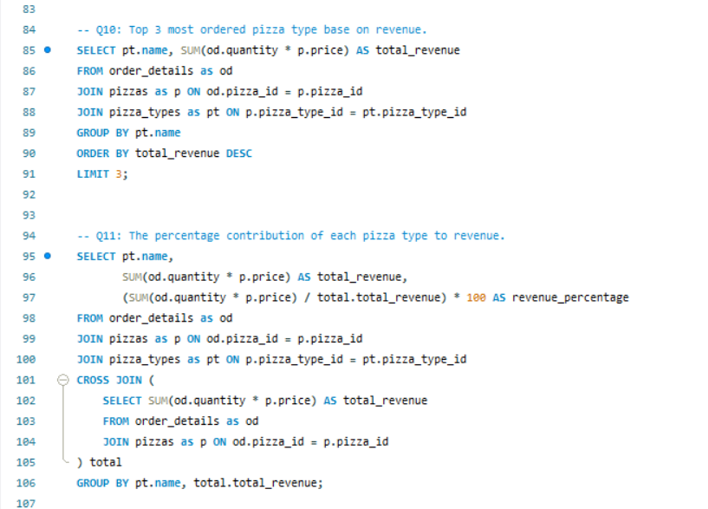

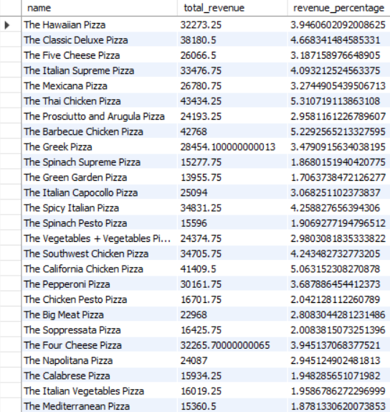
Q10: Top 3 most ordered pizza type base on revenue.
Q11: The percentage contribution of each pizza type to revenue.

Slide 10
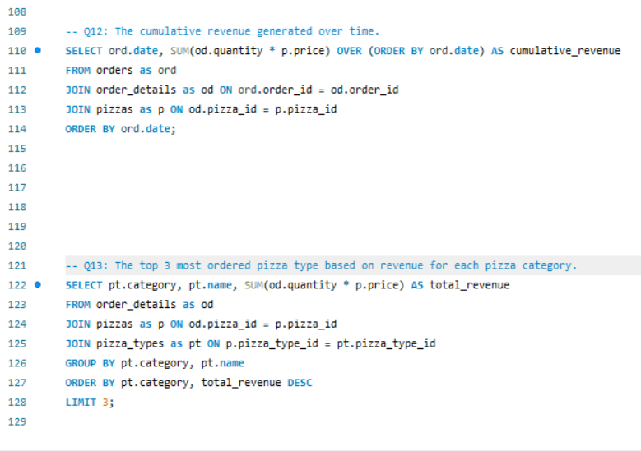
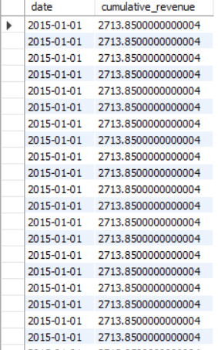

Q12: The cumulative revenue generated over time.
Q13: The top 3 most ordered pizza type based on revenue for each pizza category.

